Slide 1
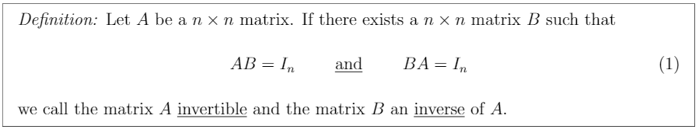
Invertible definition
By symmetry, if the matrix A is invertible with inverse B, then matrix B is also invertible with inverse A.
((A^-1)^-1) = A.

Slide 2
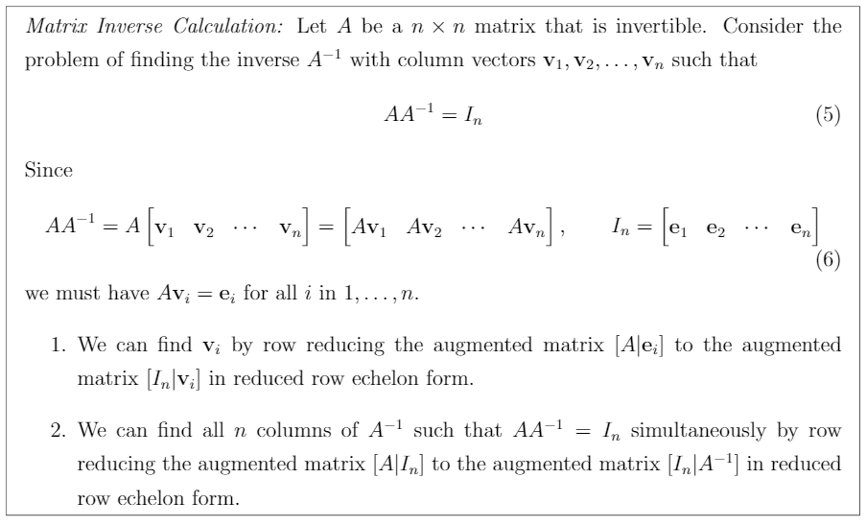
Matrix Inverse Calculation

Slide 3
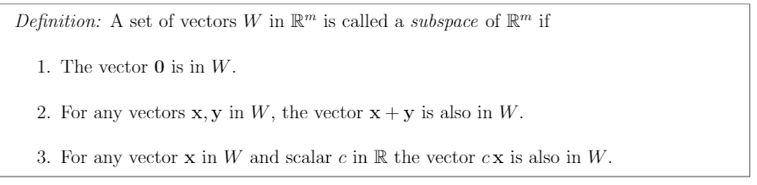
Subspace

Slide 4

Subspace and Span

Slide 5
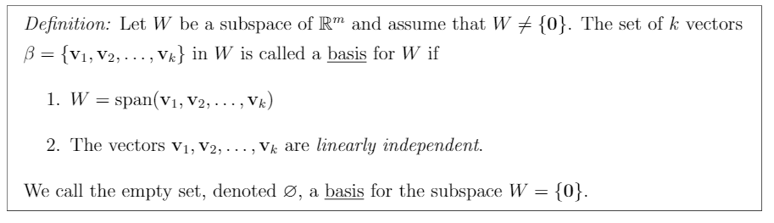
Basis

Slide 6
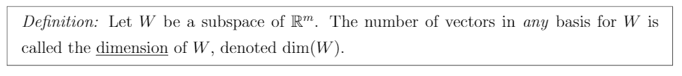
Dimension

Slide 7
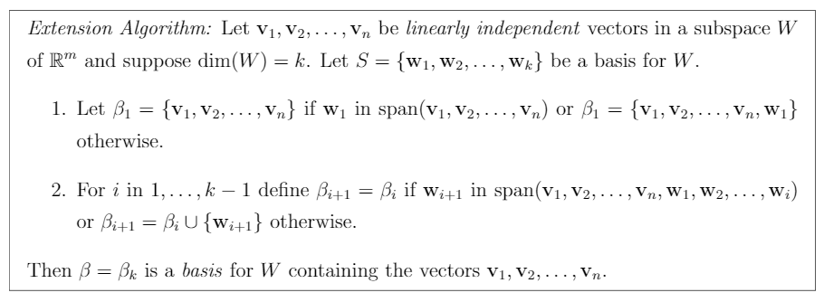
Extension Algorithm

Slide 8
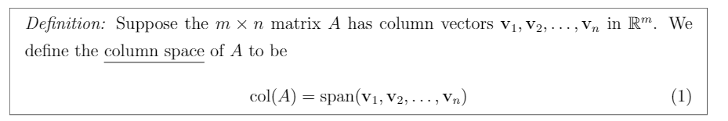
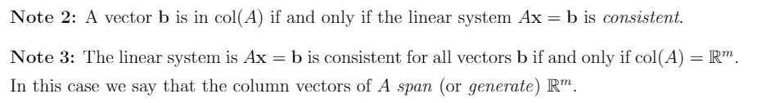
Column Space

Slide 9
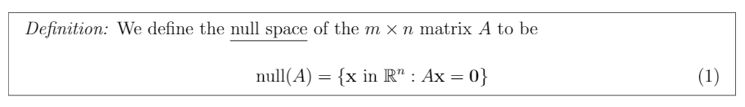
Null Space

Slide 10
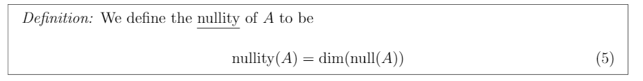
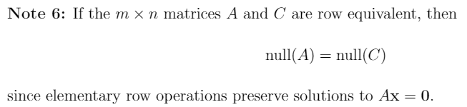
Nullity

